Slide 1
Tips for Middle
School Success
OCSA 2021-2022

Slide 2
• Mr. Arrington- School Counselor for Band, Orchestra, and Vocal
• Mrs. Karaki- School Counselor for Dance, Creative Writing, Visual
Arts
Your Guidance
• Mrs. Gill- College and Career Counselor
Department
• Mrs. Frederick- School Social Worker
• Ms. Millan- Guidance Secretary
• Mrs. Gleason- Attendance and Data Entry

Slide 3
Absences and Assignments
Try to be at school everyday.
• Make sure to make up work when you are absent. Check with the teacher to see if make up work will be accepted
• Make sure to complete and submit all work. Make sure you know when it is purple day (Pds. 1, 2, 3, and 4) and
teal day (Pds. 5, 6, 3, and 7).

Slide 4
High School Level
• If you do well in school, these classes will start in 7th grade.
• These classes will count towards high school graduation and will affect GPA and opportunities further on in your school career.
Classes in MS
• Algebra I End of Course Exam must be passed for graduation.

Slide 5
You will still have some state testing
Testing
.Your Teachers are preparing you everyday.
Check your grades often on Focus to monitor your progress

Slide 6
• If it is an emergency and you are face to face, please tell your
teacher or parent (if you are digital). We will see you as soon as we can.
How to see your
• If it is not an emergency, please book an appointment with us. Mr. Arrington- calendly.com/arringtc
counselor
• Ms. Karaki- calendly.com/rkaraki
• Mrs. Frederick- see Mr. Arrington or Mrs. Wietor first unless you have already been seeing Mrs. Frederick
• Mrs. Gill- calendly.com/msgill

Slide 7
Xello- Career Lessons
• We will be doing career lessons through Xello on August 20th
• Xello is located on your classlink, please do all tasks assigned.
• Remind Codes, Please Join, Text to number 81010:
• 6th grade- @ecgb6he
• 7th grade- @kdkf6h
• 8th grade- @732a876

Slide 8
PASSWORD RESET before Xello lesson! Make sure you know your ID number!

Slide 9
• Bullying is not tolerated at OCSA
Bullying
• If someone is bothering you, please tell a trusted adult or parent

Slide 10
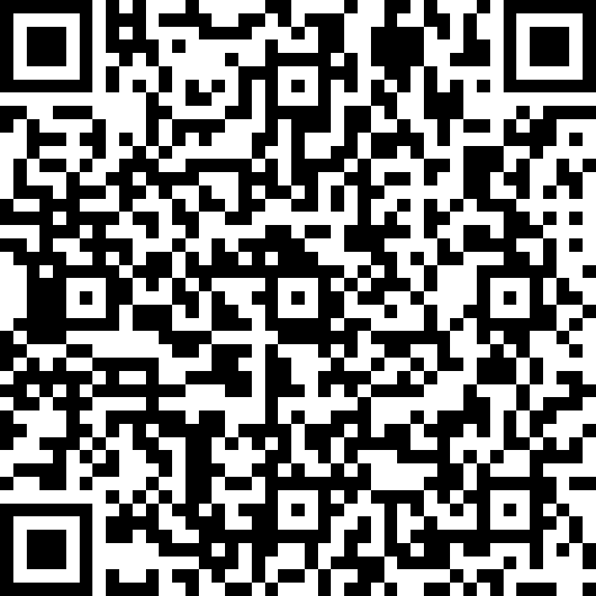
Beginning of the Year Check-In
The counseling team would love to get to know you! This information will help us when we meet with you individually.
Your information will only be shared with the following people: Mr. Arrington, Ms. Karaki, Ms. Gill, and Ms. Fredrick.
Exception: Safety issues

Slide 11
Have a great year!!!!!

